Slide 1
Evaluation with in Y Mentors Literacy and Healthy Matters Program
Lianna Sanders
University YMCA

Slide 2
Y Mentors Literacy and Healthy Matters
Campus Y
Partnership with the University of Minnesota, America Reads
Program began 2012-2013
Y Tutors and Y Buddies

Slide 3
The Y Mentors Literacy and Healthy Matters program began in fall 2012 and serves young people in after school community sites within the Twin Cities. It is a collaboration between the University of Minnesota America Reads program, Multicultural Center for Academic Excellence Family Literacy Program and the UY. The Y Mentors program has strong connections to its community partners in Minneapolis Public Schools Community Education department, Eastside Neighborhood Services, West Metro Education Partnership and Trinity Lutheran Safe Center. The Y Mentors program provides an opportunity for college students to serve as a positive role models to youth. As these relationships solidify, Y Mentors engage with their mentees to develop positive attitudes toward reading as well as to build a positive view of the young person’s personal future. Back at the UY, site leaders engage the mentors from their sites in literacy curriculum planning nights, holding discussions about experiences with their mentees and problem solving as well as attend and participate in seminars and trainings.

Slide 4
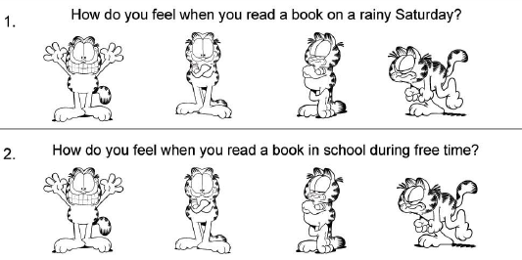
Previous Evaluation
Garfield Model
Developmental Assets

Slide 5
Development of Current Evaluation
Carlson Family Foundation
Rainbow Research
Test Group
Age Groups
Differences in surveys

Slide 6
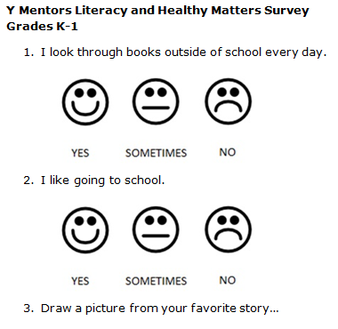
Final Evaluation

Slide 7
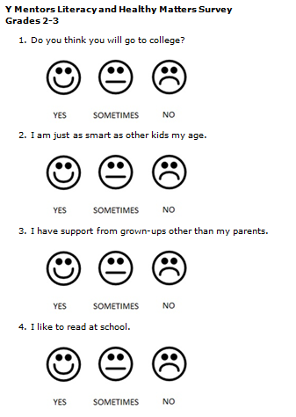
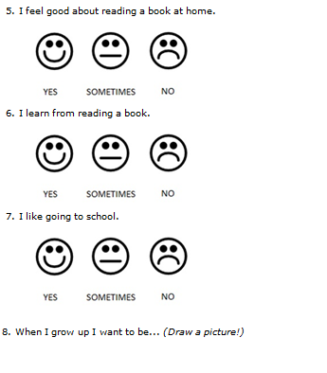

Slide 8
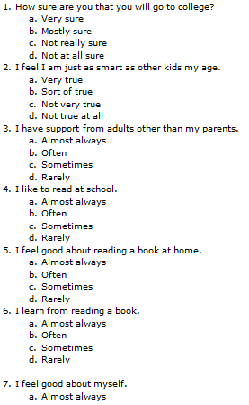
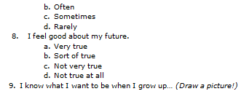

Slide 9
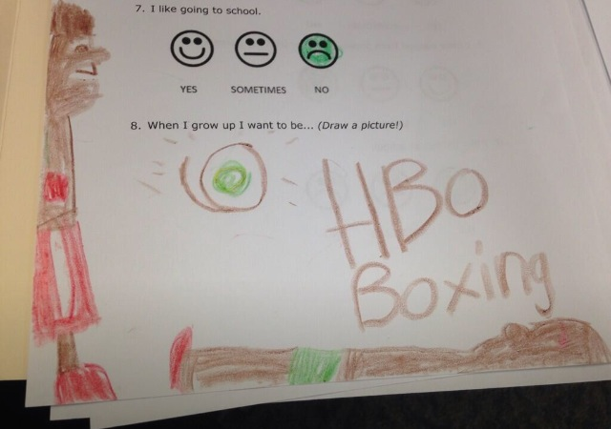
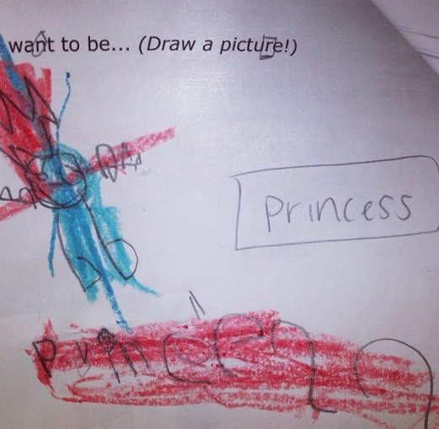
Pre- Test Results
ID [First initial first name, first initial last name, birthdate (mmddyy)] | Age | Gender | Race | PreQ1. I look through books outside of school every day. | PostQ1. I look through books outside of school everyday. | Change in Q1 | PreQ2. I like going to school. | PostQ2. I like going to school. | Change in Q2 | Draw a picture from your favorite story…
MG1 | 6 | Female |  | 3 |  | -3 | 2 |  | -2 | Wizard of Oz
AD1 | 6 | Female |  | 3 |  | -3 | 3 |  | -3 | Pidegon and a cookie
KK1 | 6 | Female |  | 2 |  | -2 | 3 |  | -3 | Oz, Great and Powerful
DS1 | 5 | Male |  | 2 |  | -2 | 3 |  | -3 | Nemo
AM1 | 6 | Male |  | 3 |  | -3 | 3 |  | -3 | Junie B Jones
SF1 | 6 | Female |  | 2 |  | -2 | 3 |  | -3 | Mickey
NA1 | 5 | Female |  | 3 |  | -3 | 1 |  | -1 | Monsters High
AH1 | 5 | Female |  | 3 |  | -3 | 1 |  | -1 | Rapunzel

Slide 10
Troubleshooting
Wrong survey
Collecting demographics
Copying/ Peer influence
Scientist
Superman
Singer
Police Officer | Scribbled all over
Police Officer
Bus driver
Superhero
Fireman

