Slide 1
Understanding Job Posts
Day 7

Slide 2
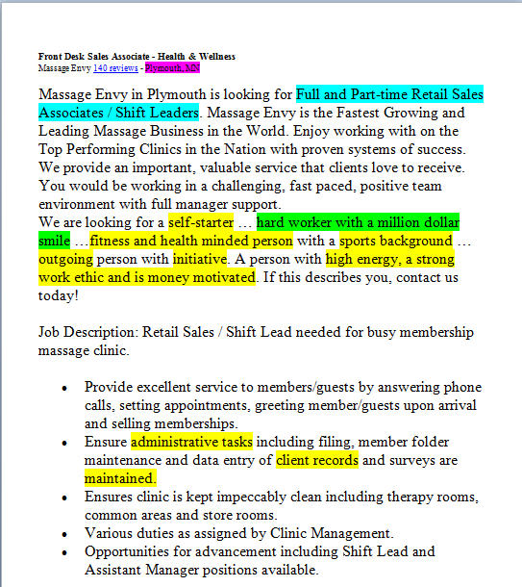
How to Read a Job Description
Keywords
Additional Keywords & Desired Experience
Hours & Pay
Location

Slide 3
Note: if you want to save time when reading many postings, begin reading with the requirements section. It will let you know right away if it is worth putting more effort into this position.

Slide 4
Is the position within reach? Right now?
Desired vs. Required
Desired Qualifications
3 years of experience
Bi-lingual
Required Qualifications
High School diploma or GED required
1+ year of customer service experience with claims analyzing and solving customer problems is required
Proficiency with Microsoft Word and Excel required
Authorization to work in the United States

Slide 5
Let’s go through some examples together
Read through the Job Search Exercise: Reading Job Posts handout
Underline keywords
Circle desired experience
(Parenthesis) around hours and pay

